Slide 1
Annual Meeting for Directors of Teaching & Senior Tutors
Wednesday 20 September 2023

Slide 3
Panel: Plans and priorities for the coming year
Prof. Bhaskar Vira, Pro-Vice-Chancellor for Education
Caredig ap Tomos, CSU Access, Education & Participation (UG)
Dr Judith Bunbury, Associate Secretary, Senior Tutors’ Committee

Slide 4
Addressing inequities in on-course educational experiences and outcomes

Slide 5
Causes of differential outcomes: for types of explanatory factors
Students’ experience of higher education learning, teaching and assessment (‘curriculum’ in broadest sense’)
Relationships between staff and students and among students
‘a sense of ‘belonging’ emerged as a key determinant of student outcomes’
Curricular and social capital
‘students’ experiences and engagement are related to […] feeling that they ‘belong’ in the institutional environment’
Psychosocial and identity factors
such as the expectations which academics have about individual students or student groups and that students have about themselves’
Mountford-Zimdars et al, 2015, ‘ Causes of differences in student outcomes’

Slide 6
‘supporting aspects of learning’ which encourage students to feel that they ‘belong’ at university, so that students feel personally accepted, included and supported by others in the [institutional] social environment and which frame learning in terms of a ‘growth mindset’
early opportunities for formative assessment and feedback’ which establish a culture of academic achievement
‘universal design for learning’, as distinct to individualised adaptations
distinguish between mental health provision and a ‘positive learning environment that fosters positive mental wellbeing’

Slide 7
encouraging ‘pedagogy-driven approaches’, underpinned by ‘a policy framework at the institutional level which rewards staff for innovating’
‘embedding’ priorities of addressing awarding gaps ‘into institutional decision-making mechanisms (such as committees and other fora) and processes (such as quality assessments)’
promoting and recognising active staff engagement in the agenda and sharing resources and practice and celebrating success within the institution and across the sector
encouraging students as partners to be involved in finding barriers and enablers for inclusive educational practices and experiences
considering how to support peer support and learning among students and student networks

Slide 8
Perspectives from Engineering

Slide 9
Engineering Tripos Part I Reform
Seb Savory
Electrical Engineering Division, Department of Engineering

Slide 10
Engineering Part I
Heritage is the Mechanical Sciences Tripos which was first sat in 1894 from which, Part I of the Engineering Tripos emerged in 1969
Since then, its structure has been revised 4 times,
1972 (removal of the General Paper)
1977 (moving to Part IA/IB from Prelims and Part I)
1985 (all mathematics moved to IA, with fewer examinations and the removal of General and Electrical Options)
1992 4-year MEng was introduced (and mathematics redistributed across IA and IB)
Proposed that the structure be reorganised to strengthen links between different branches of engineering to provide a strong foundation in engineering

Slide 11
Current Engineering Part I (since 1992)
IA
Paper 1 - Mathematics
Paper 2 - Mechanical Engineering
Paper 3 - Materials and Structural Mechanics
Paper 4 - Electrical and Information Engineering
IB
Paper 1 - Mechanics
Paper 2 – Structures
Paper 3 – Materials
Paper 4 – Thermofluid mechanics
Paper 5 – Electrical Engineering
Paper 6 - Information Engineering
Paper 7 – Mathematical Methods
All engineers study same topics for first five terms, for Easter term in IB there are
Paper 8 – Selected Topics

Slide 12
Reforming Engineering Part I – elements within each paper
IA (all 3-hour exams)
Paper 1 - Mathematics
Paper 2 - Mechanics, mechanical vibrations, fluid mechanics, thermodynamics
Paper 3 – Materials, structural mechanics
Paper 4 - Electromagnetics, electrical power, electronic circuits, digital circuits
IB (2-hour exams except where noted)
Paper 1 - Mechanics
Paper 2 – Structures
Paper 3 - Materials
Paper 4 –Thermodynamics, fluid mechanics
Paper 5 – electronic circuits, electrical power, electromagnetic fields and waves (for communications)
Paper 6 - Linear Systems and control, communications, Fourier transforms & signal and data analysis
Paper 7 – Mathematical Methods

Slide 13
Reforming Engineering Part I - regrouping
IA
Mathematics, computing
Mechanics, mechanical vibrations, fluid mechanics, thermodynamics
Structures, materials
Electromagnetics, magnetic materials, electrical power, electronic circuits, digital circuits
IB
Mechanics
Structures
Materials
Thermodynamics, fluid mechanics
electronic circuits, electrical power, electromagnetic fields and waves (for communications)
Linear systems, control, communications, Fourier transforms & signal and data analysis
Mathematical methods
Energy Systems: Thermodynamics, electromagnetics, electrical power
UN Sustainable development goal 7: Ensure access to affordable, reliable, sustainable and modern energy

Slide 14
Regrouping Engineering Part I
IA
Mathematics, computing
Mechanics, Mechanical Vibrations, Fluid mechanics, thermodynamics
Structures, materials
Electromagnetics, magnetic materials, electrical power, electronic circuits, digital circuits
IB
Mechanics
Structures
Materials
Thermodynamics, fluid mechanics
electronic circuits, electrical power, electromagnetic fields and waves (for communications)
Linear systems, control, communications, Fourier transforms & signal and data analysis
Mathematical methods
Energy Systems: Thermodynamics, electromagnetics, electrical power
Linear systems: Linear systems, electronic circuits, mechanical vibrations, control

Slide 15
Proposed structure
Proposed that Part I of the Engineering Tripos be reorganised to strengthen links between different branches of engineering to provide a strong foundation in engineering allowing a holistic approach to analysis, synthesis and design
Broad education allows graduates to address global engineering challenges such as those reflected in the UN Sustainable Development Goals (interwoven throughout the course)
Proposed that there would be eight papers spanning IA and IB,
Mathematical and Computational Methods
Six engineering science papers
digital systems and communications
dynamics and fluid mechanics
energy systems
linear systems and electronic circuits
materials and manufacturing
structures and solid mechanics
Engineering Practice (which might be 100% coursework)
Same structure for IA and IB allows for stronger integration with groups of 10 or fewer academics
horizontal – within a year (paper leads, DHoD and DUE)
vertical – between years (all lecturers on a paper, DHoD and DUE)
For part I may need to move away from Divisional based teaching groups to year-based teaching groups

Slide 16
Next steps
Once overall structure has been agreed upon
Examine content to be taught
Modes of teaching – e.g. lectures, experimental work, project work etc.
Consider modes of assessment particularly with regards to addressing awarding gaps

Slide 17
Proposed timeline
July 2023 – outline structure circulated for comments (current content is mapped on to the new structure from the existing Part I)
Academic year 2023/24 – draw up the paperwork for major course modification in consultation with major stakeholders including teaching staff, students, industry and the Professional Engineering Institutions
Michaelmas Term 2024 - paperwork for major course modification to pass through various formal committees for approval, including Faculty Board, School of Technology Education committee, Senior Tutors’ Education committee, Academic Standards and Enhancement Committee (first pass in November 2024)
January 2025 - Academic Standards and Enhancement Committee (final approval)
February 2025 - formally launch the reformed Part I, with an appropriately revised on-line prospectus entry
Michaelmas Term 2026 – first intake for reformed Part I

Slide 18
Exploring undergraduate Engineering students’ learning experiences of Part I
Aakash Gupta and Kamilah Jooganah
Wider research team: John Durrell, Megan Davies Wykes, Juliette Rudelle

Slide 19
Research rationale/background
A persistent gender awarding gap with male students more likely to be awarded a First
34.7% of male students obtain a 1st in comparison to 17.4% of female students
84.3% of male students "good degree" in comparison to 82.6% of female students (“good degree”: 1st or 2.1)
This persistent gender awarding gap is observed across all Tripos years, particularly Part IB
2018-19: 33.1% of male students being awarded a 1st in comparison to 8.5% of female students
Investigating the ethnicity and disability awarding gaps within engineering at Cambridge is harder because numbers are too small to draw conclusive findings, but sector data tell us there is an issue with student access and success in Engineering (Engineering UK, 2020).
“The experiences prospective engineers have at university can sometimes appear to set the tone in terms of how welcomed they feel when trying to enter the profession. A poor experience stays with engineers for some time and even appears to impact their confidence in their ability or chances of progression – even once they have qualified and started employment.”
Royal Academy of Engineering (2023, pg. 31)
Lack of ‘quantitative data’ does not mean that there is not a problem, and not taking any action is not an option, especially given the opportunity to reform Part 1

Slide 20
Research aim and questions
Overarching research aim
To explore undergraduate Engineering students’ learning experiences of Part I with respect to enhancing inclusive educational practices (i.e. the curriculum, teaching and assessment)
Research questions and method
What are the enablers and barriers to students’ academic success as it relates to Part I?
2) How can the curriculum, teaching and assessment methods in Part I be enhanced to support students’ academic success?
Pre-focus group questionnaire (2 open-ended questions; option 1:1 interviews) and focus groups
Sample population: UG Engineering students (all years)
2 focus groups. 2 interviews. 19 responses to questionnaire. More focus groups lined up.

Slide 21
Preliminary findings
What are the enablers to students’ academic success as it relates to Part I?
Supervisions and working with peers
Being able to rely on experience from older students
General nature of Engineering Tripos
Application of real-world examples and case studies in particular courses e.g. structures
Approachable lecturers
Departmental activities and events to engage students – societies, guest talks, free pizza at events, canteen, a feeling that the Department cares for the students

Slide 22
Engineering department positives – student quotes
“Supervisions and working with my peers has been a great way to develop academically.” (1st year, male student)
“My subject parents at my college were very helpful when first starting uni and provided lots of useful information and advice. Being in a group of engineers in my college made me feel like I wasn't going it alone and was almost part of a team” (2nd year, male student)
“Supervisions kept me working at a good pace as I had to constantly work throughout the terms. The college system in general meant that I quickly became close to the engineers in my college and having a DoS meant that any concerns with the course could be addressed to him” (3rd yr, female student)
“I benefitted from being exposed to more engineering fields in my first and second year. Initially when applying to university I wanted to do aerospace engineering, however it turned out I enjoyed electrical engineering more which is what I ended up pursuing” (3rd yr, female student)
“I also like the inclusion of real-world applications in some subjects. For example, we have plenty of case studies in structures course. These are very helpful for us to truly get an idea of where can we apply these knowledge. As engineering students, knowing about how knowledge is applied is important” (1st yr, male student)

Slide 23
Major challenge – Part IB Exams
High-stakes exams being an unrealistic and unrepresentative form of assessment that create unnecessary barriers for students
Condensed exam timetable allows for multiple external barriers e.g. illness
Many of these barriers affect certain groups more than others
Students with a disability/reasonable adjustments
Students who menstruate
For second year, I feel that exams are so condensed in such a small amount of time, I was ill at some point during them. It didn't really represent my best ability. It's just not a good representation of how people understand things.
“I had problems with my back as well at the time, I couldn't even lift my head. That's how much pain I was in by day five”
“If you're on your period, midway through the exams, you know, a lot of people do have really horrible pain. I've had friends who are basically bedridden for the first few days..”

Slide 24
Other barriers to academic success
Lack of female representation amongst lecturers and faculty
Academic research shows this is important to improving female participation and increasing confidence
Sense of belonging through peer networks can be of particular significance to female students and racially minoritised female students in STEM subjects (Wong et. al., 2021)
Women instructors in Engineering can increase female participation and confidence in academic settings (Dutta and Arnold, 2022)
Better ways to report incidences relating to protected characteristics e.g. incident where student had their “abilities downplayed” and were “actively shunned out of groupwork” due to their race and gender
“The group of students at my college in my year is really great and sharing engineering with a bunch of cool women has been really helpful in not making me feel different for my gender” (2nd year, female student)
“The gender balance of lectures has been somewhat frustrating for me; I can't quite explain it but having a female lecturer really boosts my confidence and makes me feel more seen” (2nd yr, female student)

Slide 25
How do we create a more inclusive learning experience in Part I?
Reviewing learning and teaching materials e.g. how are people with protected characteristics portrayed
Can students see their identities positively reflected in what and how they are taught?
Assessment – building on good practice, authentic assessment. Working with ADRC to explore how we can remove unnecessary barriers to students' experiences of assessment.
Opportunities to create peer groups for female students, especially from ethnic minority backgrounds
Cambridge University Women in Engineering Society are planning on launching an online introduction to navigating the curriculum aimed at incoming female students.

Slide 26
Next steps
Continue with data collection through focus groups and interviews
Analyse exam data, question type and performance by gender
Situate findings and recommendations within broader landscape of literatures/research
Produce report to share with Department containing suggested recommendations
Thank you for listening. We welcome any reflections, comments and feedback.

Slide 27
Unrealistic and unrepresentative IB exams – student quotes
“For second year, I feel that exams are so condensed in such a small amount of time, I was ill at some point during them. It didn't really represent my best ability. It's just not a good representation of how people understand things”
“The exam that I understood, basically nothing in, I got my highest grade in, just because it was the first one, so I revised for that one. And for the others I ran out of time. Yeah, the proper, like, you know, last minute revision if you want to say it that way, and that shows. Because as soon as I had a weekend in between exams, my grades went up again by like, 10%. Because I had a break and I was just able to put my head down for two days and only looked at that subject without being interrupted” (2nd yr, female student)
“There's no need to have three-hour exams. In fact, the papers break down into section A's, like structure sections, B, materials. Why is it a three-hour exam condensed? Just make it two 1hr and a half hour exams. Because the papers never talk to each other, like they are two different halves because they are different topics”
“If you have all your exams within that space, a week, basically, what you're doing is you're giving people a much higher chance of like, if they feel ill on one day, or a few days in a row, it's not going to affect just one exam, it will affect half of them”

Slide 28
References
Blosser, E. (2020) An examination of Black women's experiences in undergraduate engineering on a primarily white campus: Considering institutional strategies for change. Journal of Engineering Education, 109, pp. 52–71. https://doi.org/10.1002/jee.20304
Dutta, N. S., and Arnold, C. B. (2022). Illuminating the Role of Classmates in Reducing the Participation Gender Gap in Lecture-Based Engineering Classes. IEEE Transactions on Education, vol. 65, no. 4, pp. 584-591.
Engineering UK (2020). Educational Pathways into Engineering. Available at: www.engineeringuk.com%2Fmedia%2F232298%2Fengineering-uk-report-2020.pdf [Accessed 1 June 2023].
Royal Academy of Engineering (2023). Royal Academy of Engineering: Cultural Inclusivity in Engineering. Available at: https://raeng.org.uk/media/w5ndkndk/cultural-inclusivity-in-engineering-main-report-final.pdf [Accessed 1 June 2023].
Wong, B., Copsey-Blake, M., and El-Morally, R (2021). The Student Experiences in STEM Report Minority Ethnic Students in Higher Education. Available at: https://www.researchgate.net/publication/355034851_The_Student_Experiences_in_STEM_Report_Minority_Ethnic_Students_in_Higher_Education?channel=doi&linkId=61597e8b4a82eb7cb5e85a1d&showFulltext=true [Accessed 1 June 2023].

Slide 29
Table-based discussions

Slide 30
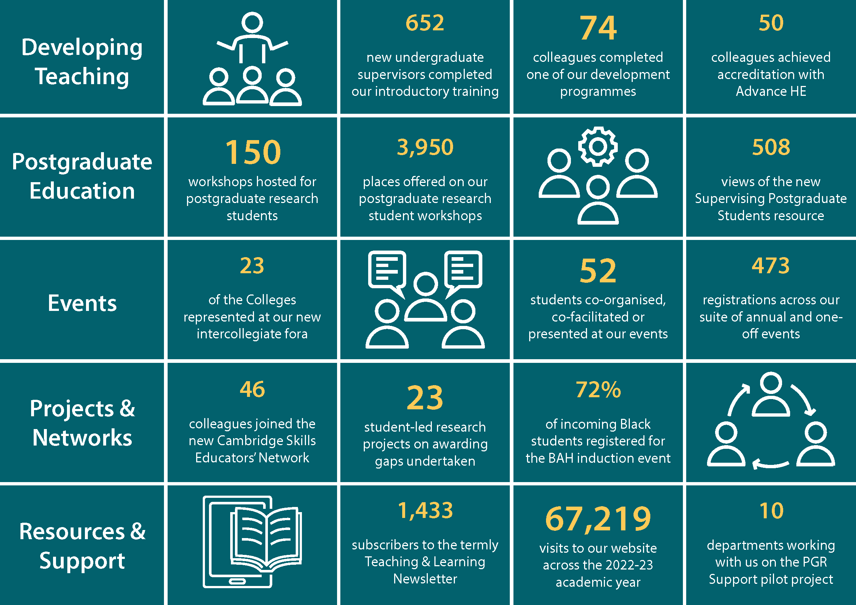
https://www.cctl.cam.ac.uk/about-cctl/year-review

Slide 31
https://tableau.blue.cam.ac.uk/#/site/InformationHub/home
Register to access Cambridge student data, including ‘awarding gaps’ by student characteristics
https://www.cctl.cam.ac.uk/inclusive-teaching
‘Working with students as partners: Guidance and resources’
https://www.cctl.cam.ac.uk/app-par-project
Access & Participation Plan: Participatory Action Research Project (APP PAR project): student-led small-scale investigations and reports
https://www.cctl.cam.ac.uk/inclusive-teaching/collegiate-education
‘Inclusive approaches to understanding and addressing awarding gaps at Cambridge: briefing paper’
https://www.cctl.cam.ac.uk/events/intercollegiate-fora/intercollegiate-fora-resources
‘Academic induction & development: responsive literature review & formative evaluation framework’

Slide 32
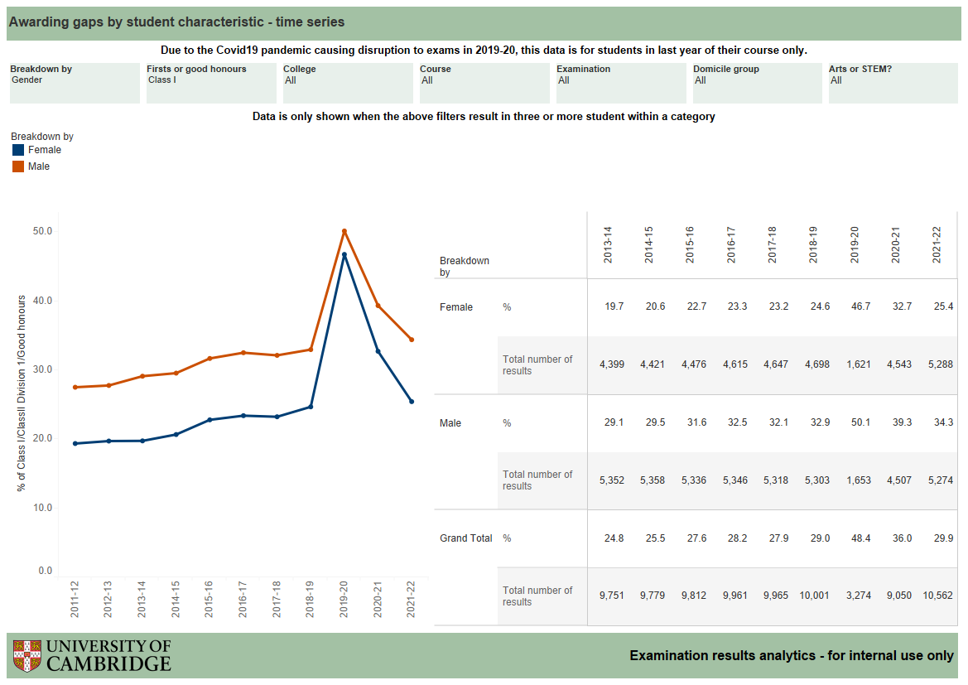
‘equality of opportunity risks’
https://tableau.blue.cam.ac.uk/#/site/InformationHub/home

