Slide 1

Pilkington Prize Ceremony
Tuesday 29 June
Welcome! We will be starting shortly.

Slide 2
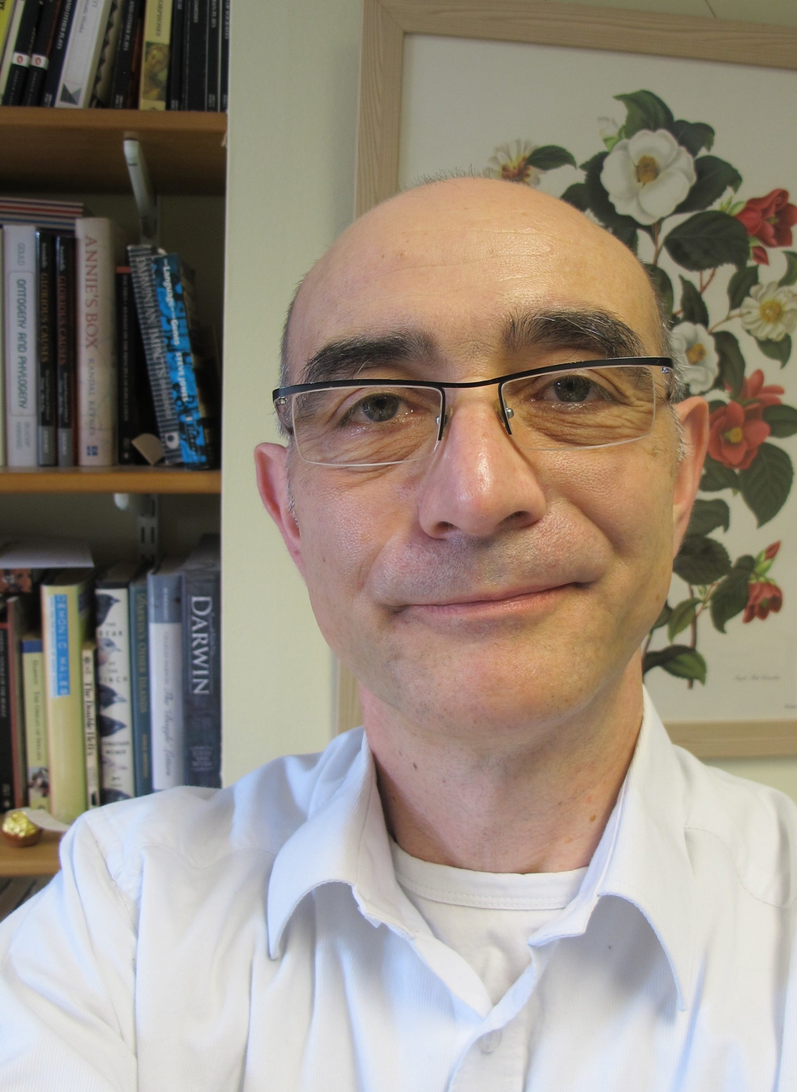
Dr David Clifford
Faculty of English, Homerton College
“Warm student testimonies speak repeatedly of how David has ‘gone the extra mile’ in enabling them to fulfil their potential.”
Notes:
“Dr David Clifford demonstrates unstinting dedication to his students, revising his teaching curricula regularly with a particular eye to access issues, and is highly committed to widening participation through summer school work, consulting for the access organisation Inside Uni and introducing College initiatives to enable students from economically-deprived backgrounds to flourish.”

Slide 3
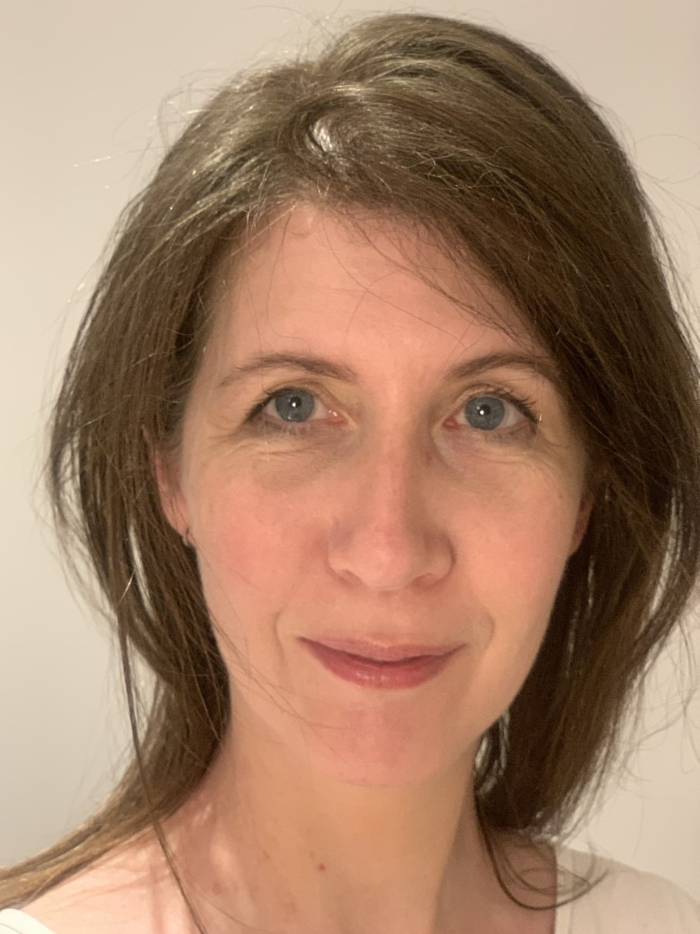
Dr Elizabeth Fistein
School of Clinical Medicine, Lucy Cavendish College
“Her students describe her as a passionate teacher, enthusiastic, kind and inspirational.”
Notes:
“Dr Elizabeth Fistein has been instrumental in developing the innovative new Medical Ethics and Law curriculum as an integrated theme across the three years of the clinical medicine course, with excellent feedback. On top of this Elizabeth is deeply involved in improving the Clinical School’s assessment processes, developing for example the innovative Structured Essay Question paper for the Final MB exam.”

Slide 4
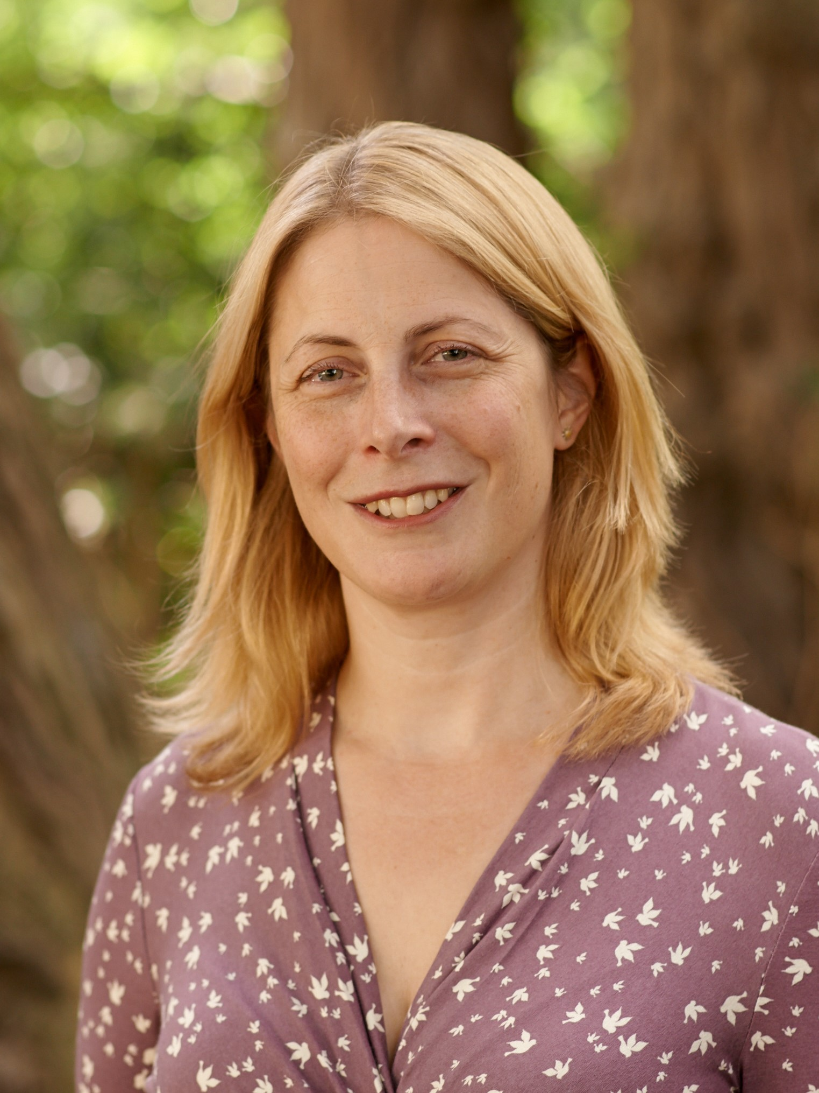
Prof. Beverley Glover
Department of Plant Sciences, Queens’ College
“She has restructured and replanted the Botanic Garden to become a living educational aid with 12,000 school visitors a year.”
Notes:
“Prof. Beverley Glover has, in her role as Director of Cambridge Botanic Garden, restructured the gardens to become a living educational aid to visitors and students of all ages. This is only in addition to her outstanding work as a lecturer which inspires first-year students to continue studying Plant Sciences, and broader outreach efforts with the BBC and Royal Society.”

Slide 5
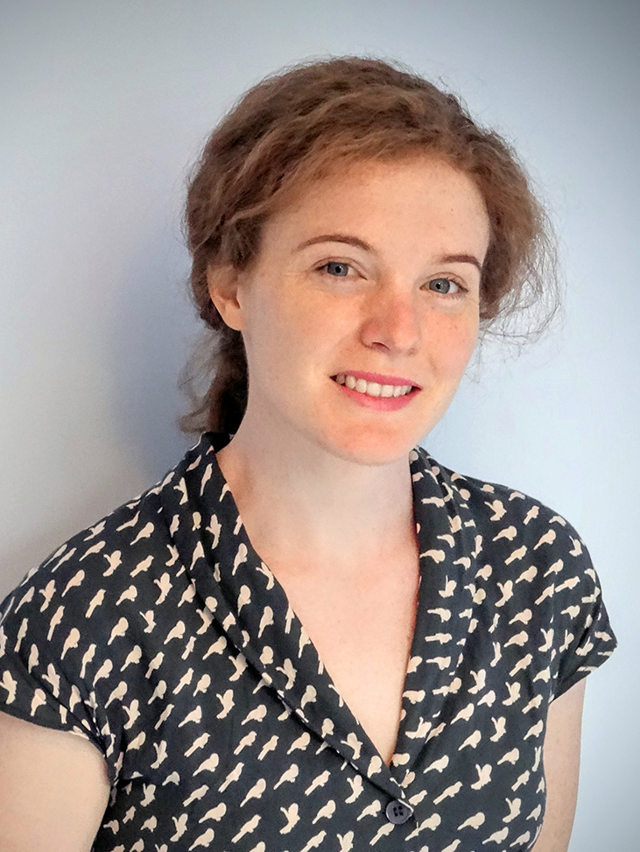
Dr Hannah Joyce
Department of Engineering, St John’s College
“Her engaging lecture style and clarity have been particularly appreciated, referencing both historical elements and popular culture.”
Notes:
“Dr Hannah Joyce consistently receives some of the highest praise from students in the Department of Engineering, and nominations for ‘Best Lecturer’, for her engaging lecture style, but she is also committed to outreach as the University coordinator for the UK Electronic Skills Foundation, which encourages undergraduates to apply for - and achieve - UKESF scholarships.”

Slide 6
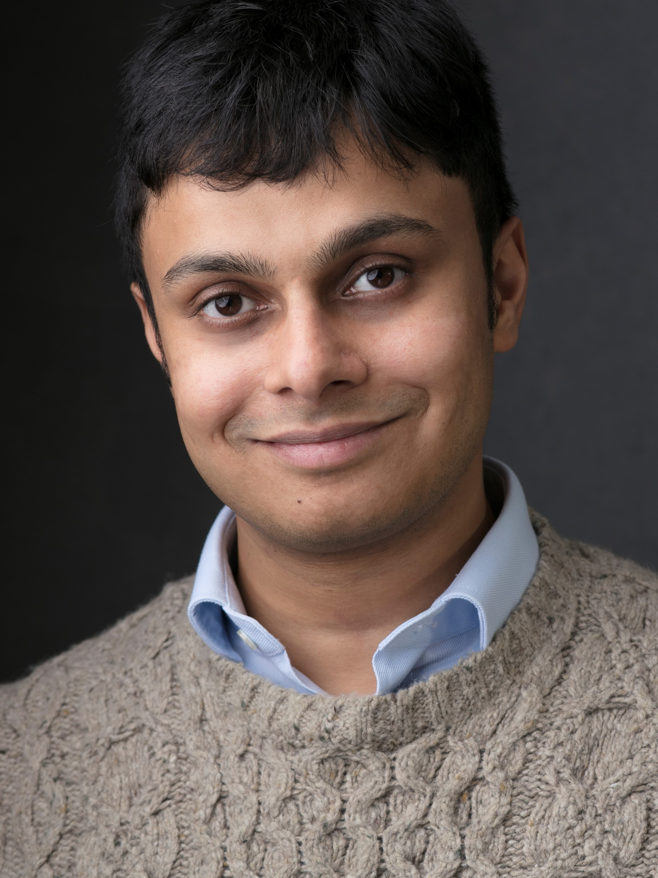
Dr Nikhil Krishnan
Faculty of Philosophy, Robinson College
“Active and in-demand as College supervisor and Director of Studies, he is known for his commitment, empathy and effectiveness.”
Notes:
“Dr Nikhil Nrishnan is an exceptional teacher in the Faculty of Philosophy, building the confidence of students initially unfamiliar with philosophy, establishing a reading group focused on broadening horizons with works outside the mainstream of philosophy, and developing new methods-oriented workshops which introduce students systematically to the demands of postgraduate work.”
“Sadly, Nikhil is unable to join us this evening, and we send our good wishes to him.”

Slide 7
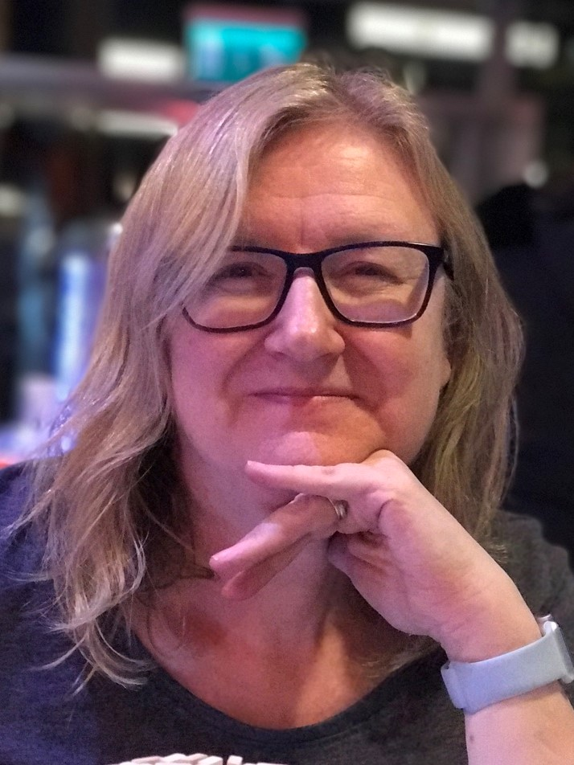
Hon. Prof. Clare Morris
Institute of Continuing Education
“Clare is a continuing educator to her very bones, and we at ICE are fortunate to benefit from her dynamism, professionalism and wisdom.”
Notes:
“Honorary Professor Clare Morris has led the development and delivery of the Institute of Continuing Education’s postgraduate medical education portfolio, now recognised as a regional beacon and leading national provider. Clare teaches by example in building inclusive communities of learning in which participants benefit greatly from the perspectives of their peers.”

Slide 8
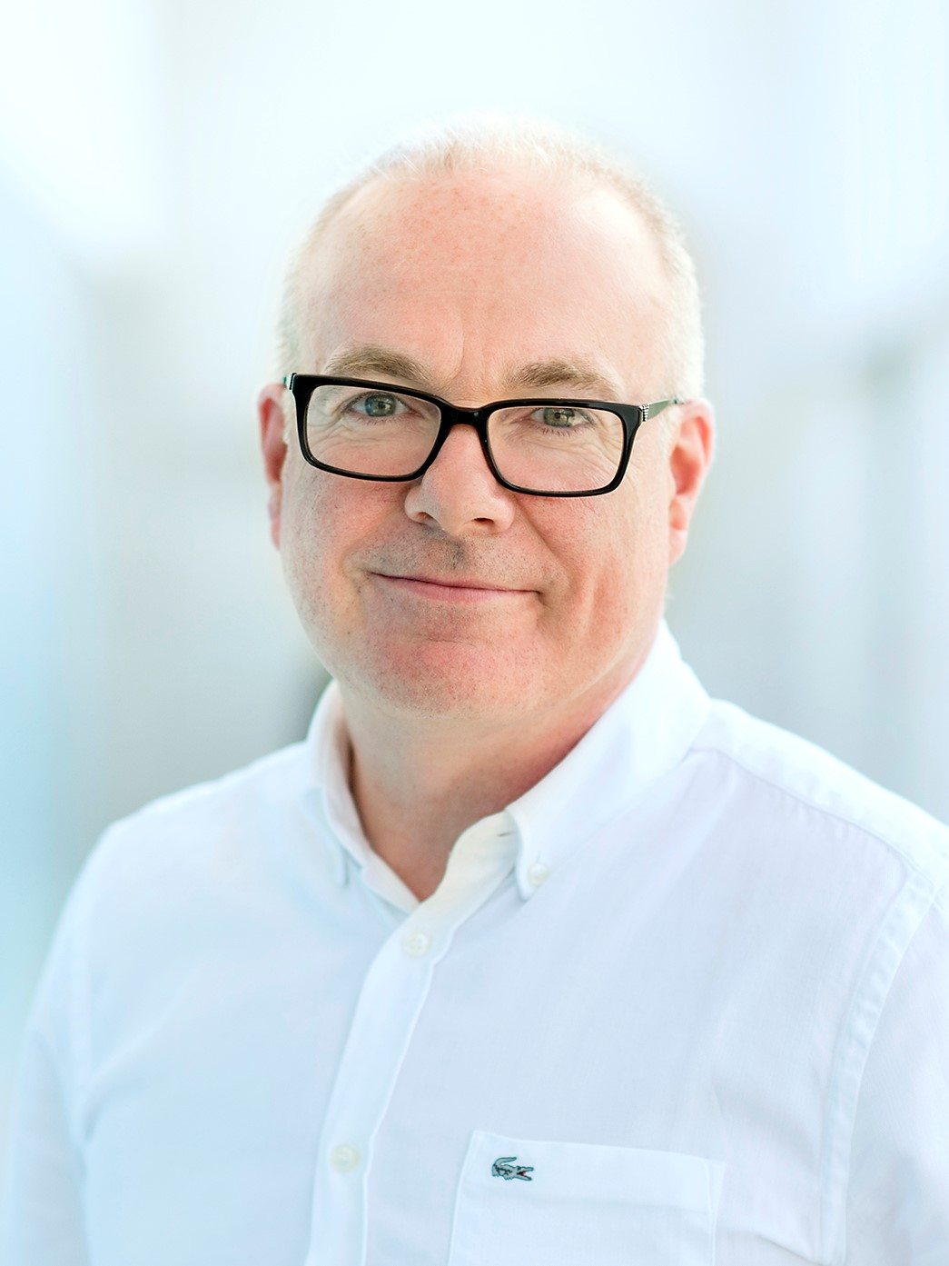
Mr Bill Nicholl
Faculty of Education, Homerton College
“His teaching has been evaluated as outstanding by students and other stakeholders throughout his tenure in the Faculty.”
Notes:
“Mr Bill Nicholl in an inspiring lecturer and innovative pedagogical leader in the area of Design & Technology, bringing a focus on design creativity and developing new course content on the role of Design in relation to discourses around race. His research-based pedagogy has influenced policy and practice far beyond his teaching in the Faculty.”

Slide 9
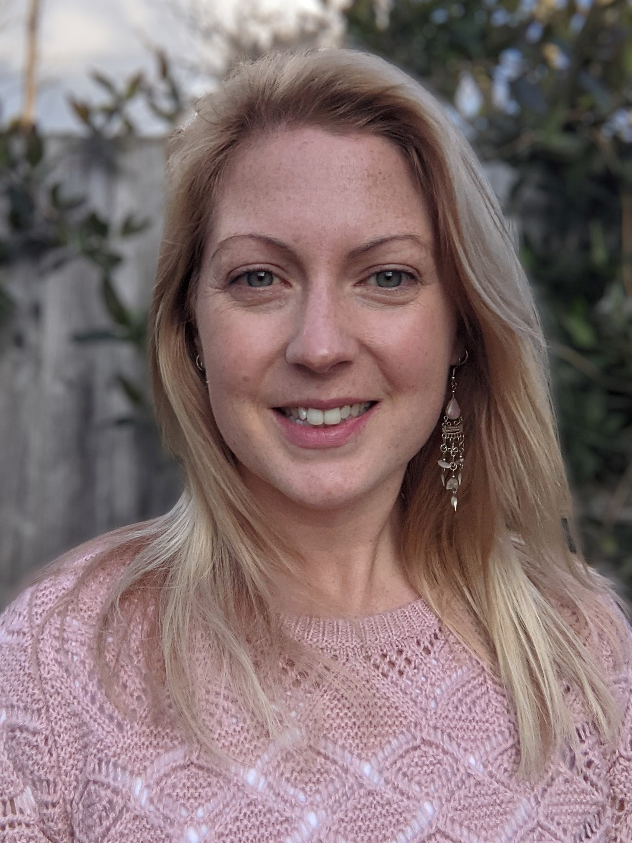
Dr Tina Potter
Department of Physics, Newnham College
“She regularly receives the best feedback for this lecture course, her projects and her research reviews, despite their challenging topics.”
Notes:
“Dr Tina Potter is an extraordinary teacher who has overhauled one of the most challenging topics in physics to teach at the undergraduate level - particle and nuclear physics - ensuring that it has become the most popular optional course in Part II physics. Tina is also a strong advocate for diversity in the Department and is committed to mentoring undergraduate students.”

Slide 10
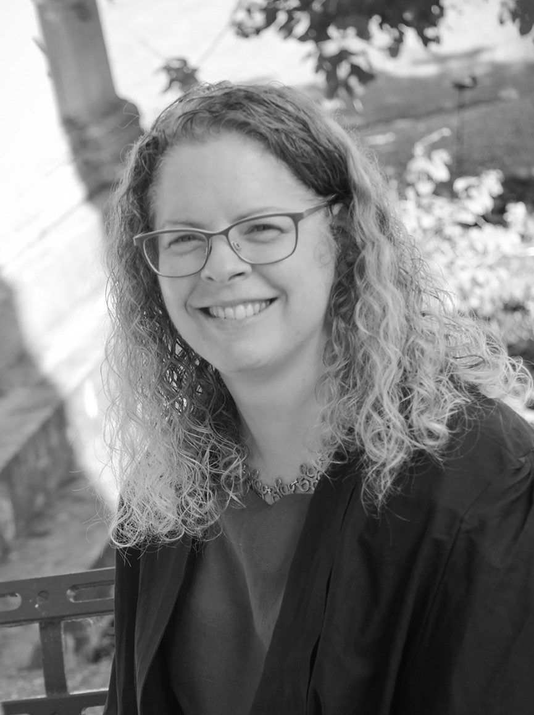
Dr Dee Scadden
Department of Biochemistry, Downing College
“Dee continues to inspire, motivate and support her colleagues in developing imaginative and academically rigorous online resources.”
Notes:
“Dr Dee Scadden is a leading figure in the University for her work in developing online teaching resources. Her timeless commitment was crucial in allowing Departments across the School of Biological Sciences to move their teaching online last year with very little notice, while she continues to inspire, motivate and support her colleagues in developing imaginative and academically rigorous teaching resources.”

Slide 11
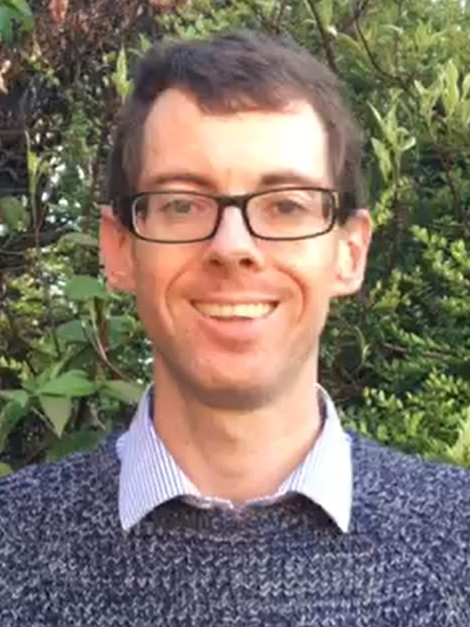
Dr Peter Sloman
Department of Politics & International Studies, Churchill College
“He is an outstanding and deeply committed teacher; students often rate Peter as the best lecturer they have ever had.”
Notes:
“Dr Peter Sloman has been the heart and soul of the new History & Politics Tripos, effectively building it from scratch over the last five years and supporting students from application to graduation. The Tripos is the single most successful programme across the University in widening participation, and Peter has worked to diversify assessment, mentor students and improve outreach.”

Slide 12
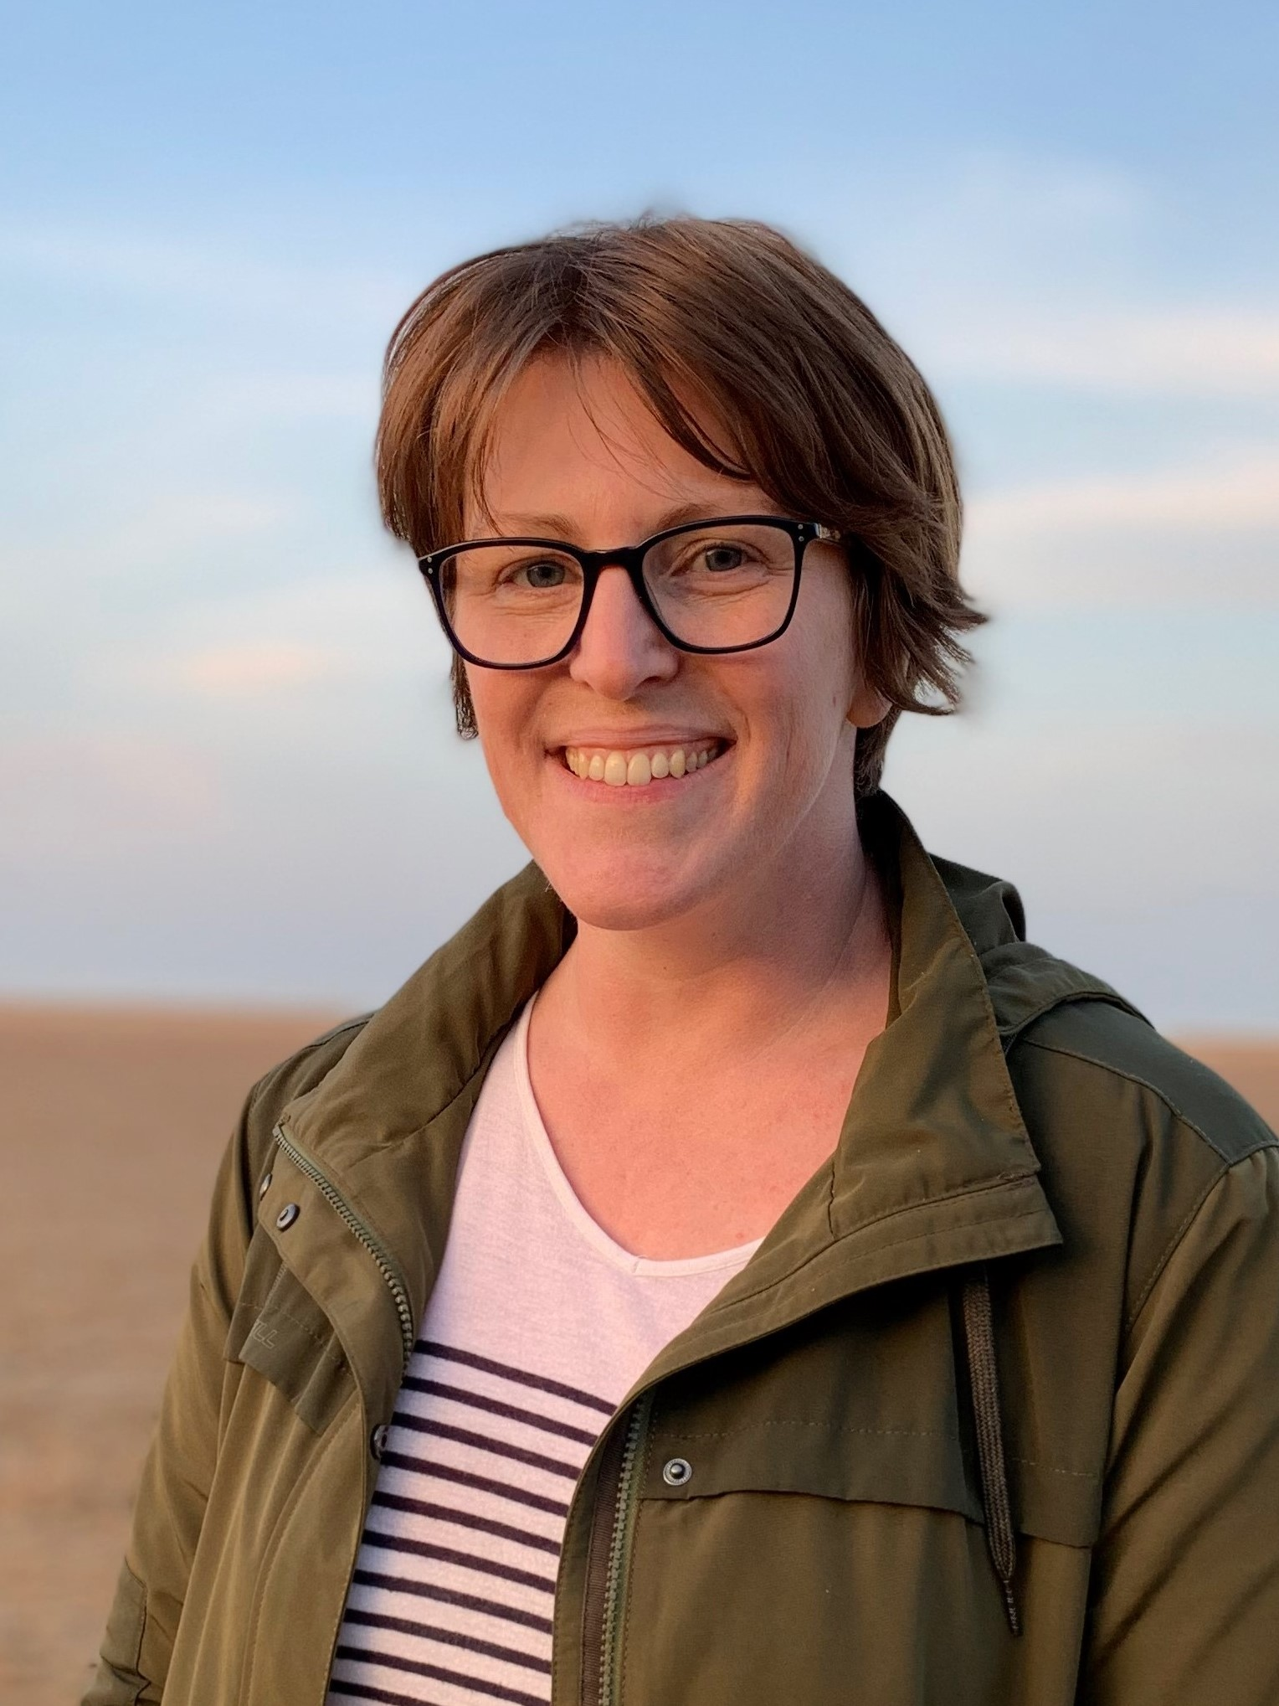
Dr Anne Swift
Department of Public Health & Primary Care
“She is frequently referred to by name in student feedback as an enthusiastic, passionate and interactive lecturer.”
Notes:
“Dr Anne Swift is an outstanding student-centred teacher, working with students in Public Health & Primary Care to develop new sessions on issues of importance to the student body such as nutrition and LGBT+ health, while introducing innovative teaching methods such as a collaboration with a drama company to convey the complexity of intimate partner violence.”

Slide 13
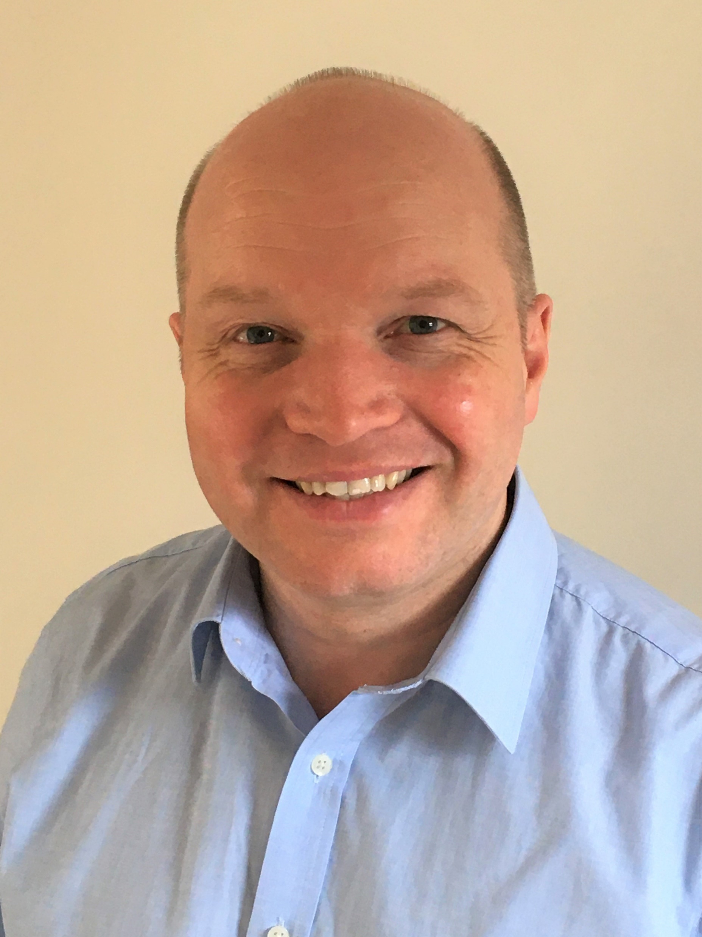
Mr Alan Thorne
Department of Engineering
“Alan is relentlessly focused on enhancing the student learning experience, and the ‘Robot Lab’ is regularly cited by students as the highlight of the course.”
Notes:
“Mr Alan Thorne has been tirelessly improving the learning experience of the ‘Robot Lab’ exercise - which has become one of the defining features of the Manufacturing Engineering Tripos - year after year since 1995. Faced with the impact of lockdown this year he scorned the easy way out and designed blended and fully online versions of the Lab so that no students would miss out on the experience.”

Slide 14
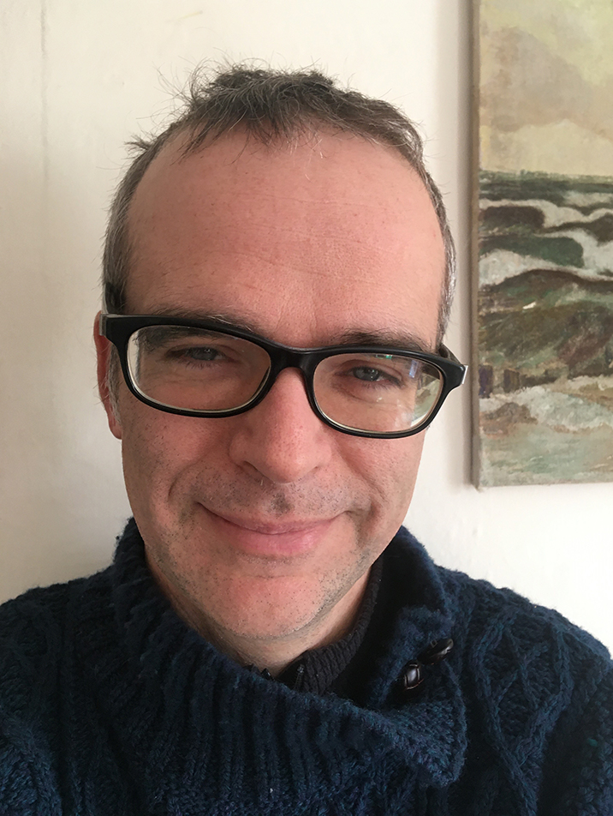
Dr Edward Tipper
Department of Earth Sciences, St John’s College
“Along with his record as an inspired instructor, he has made it his business to keep the whole of our teaching programme ahead of the curve.”
Notes:
“Dr Edward Tipper has revolutionised the way in which Earth Sciences students explore geochemical data through the development of computer-based exercises, and last year was responsible for master-minding the Department’s teaching response to Covid, allowing them to deliver a full slate of in-person practical sessions through Michaelmas Term; a truly heroic task.”

Slide 15



Notes:
“We are also, this evening, celebrating the winners of the Technology-Enabled Learning Prize. This Prize, inaugurated in 2019, is awarded by Cambridge University Press and seeks to recognize Cambridge academics and staff who have developed their own learning technology solutions - or employed existing technology in an innovative way – to improve the learning outcomes of their students.“

Slide 16
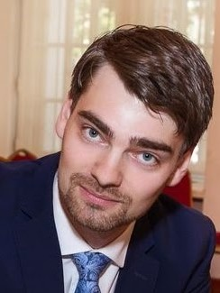
Highly commended: Dr Oleg Kitov
Faculty of Economics, Selwyn College
“Oleg has created a learning experience which fosters deeper learning while helping students to develop into independent, self-regulating and reflective lifelong learners.”
Notes:
“First of all, Dr Oleg Kitov was highly commended by the judging panel for his efforts in using formative assessment to deliver improved learning outcomes within the Economics Tripos. Oleg and colleagues used mastery-oriented active learning methods to complement traditional lectures and supervisions, incorporating opportunities for reflective feedback and enabling learner autonomy.”

Slide 17
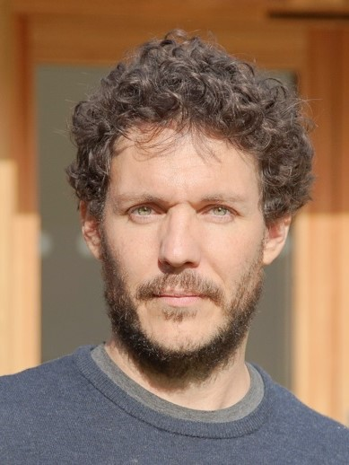
Winner, AHSS: Dr Sami Everett
Centre for Research in the Arts, Social Sciences & Humanities, St Edmund’s College
“Opportunities were created for learners to reflect critically, as well as to share and learn from examples of failure in their own ethnographic fieldwork.”
Notes:
“Winner of the AHSS Technology-Enabled Learning Prize, Dr Sami Everett led a team in delivering a highly collaborative, workshop-based programme for early-career research students wholly online, enabled by a toolkit of web-based technologies. Sami’s team employed purposeful learning design and judicious selection of accessible communication tools to bring together a diverse group to explore issues relating to digital ethnography.”

Slide 18
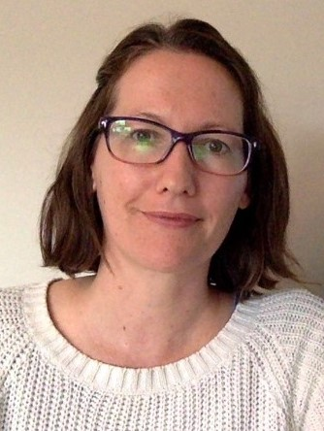
Winner, STEMM: Dr Mairi Kilkenny
St Catharine’s College
“Many students cited the quality and interactivity of the online materials as having contributed substantially to the overall success of the lecture series.”
Notes:
“Winner of the STEMM Technology-Enabled Learning Prize, Dr Mairi Kilkenny created an extensive set of educational media to enable the delivery of virtual practicals to the hundreds of Natural Sciences students, ensuring educational continuity through lockdown. Using an impressive range of carefully selected learning technologies, Mairi produced a suite of videos, illustrations and quizzes to overwhelmingly positive feedback.”

Slide 19
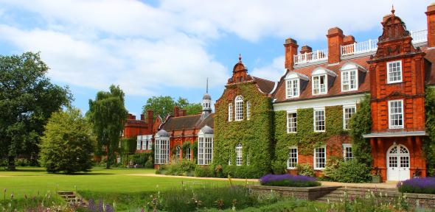
Pilkington Prize Ceremony
Tuesday 5 July 2022
We look forward to welcoming you in person

Slide 20
Thank you for joining us this evening
“I am absolutely thrilled that your marvellous and many contributions have been recognised in this spectacular way – very well done!”
“This is a lovely letter to receive at the end of a tough term!”
“I feel very honoured as really I just love my job (maybe a bit of a cliché but true!)”
“I’m rather overwhelmed and very happy for my teaching efforts to be recognised in this way. Please pass on my thanks to the VC!”
“What fantastic news – what a star you are!”
“I have to say I was rather overwhelmed to learn of my award and am delighted to accept.”

